Slide 1
Graph Structural Features lecture-2 Course on Graph Neural Networks for Knowledge Graph Systems (Winter Term 22/23)
Prof. Dr. Holger Giese (holger.giese@hpi.uni-potsdam.de)
Christian Medeiros Adriano (christian.adriano@hpi.de) - “Chris”
Matthias Barkowsky (matthias.barkowsky@hpi.de)
Iqra Zafar (iqra.zafar@hpi.de)

Slide 2
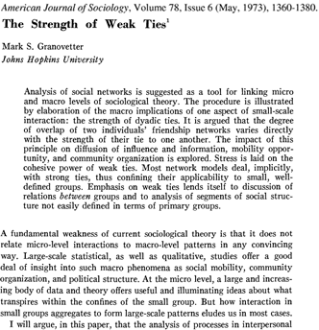
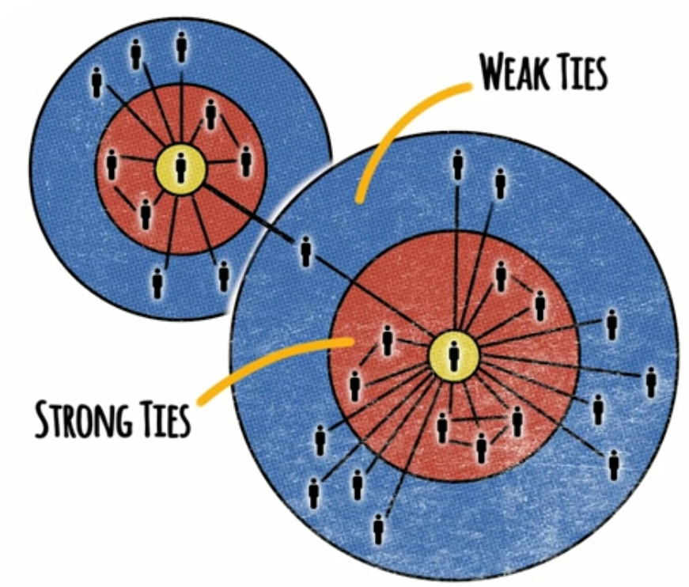
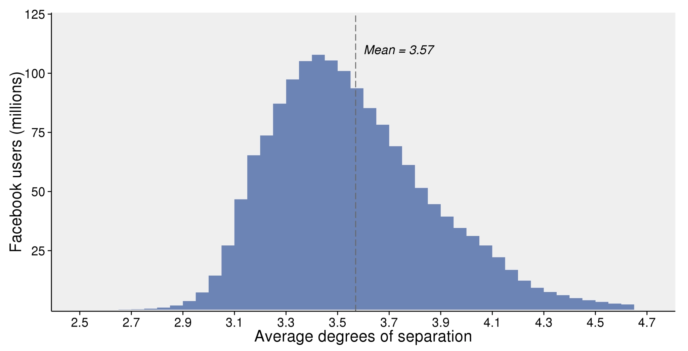

The Strength of Weak Ties [Granovetter 73]
Interesting facts:
Most people change jobs voluntarily
56% found new jobs through personal contacts
3/4 of the highest income categories
More difficult to change if>5 years in a job
People with 2 to 5 years in a job were more likely to find jobs through weak ties
source: Interview with Mark Granovetter at Stanford - https://www.youtube.com/watch?v=g3bBajcR5fE&pbjreload=101
A
Why?
B
C
D
Instant global communication
Triads tend to form -> increasing the spread of information within a cluster
Figure 1. Estimated average degrees of separation between all people on Facebook.
Shrinking average shortest paths
JJ Ying https://unsplash.com/photos/8bghKxNU1j0
https://research.fb.com/blog/2016/02/three-and-a-half-degrees-of-separation/
Notes:
Acquaintances connect us to other groups, so in a sense, they are our windows to the world.
Most people change jobs voluntarily, so they are looking for information that helps them make decisions, e.g., how does it feel to work there? What about the tasks, the colleagues, the management, etc?
56% found new jobs through personal contacts
3/4 of the highest income categories (this effect was stronger in the top earners)
Difficult to change jobs for those who were >5 years
Average job to 2 to 5 years, were more likely to find jobs through weak ties
Strength of connections leads to clusters
Sources:
https://www.youtube.com/watch?v=g3bBajcR5fE&pbjreload=101
https://research.fb.com/blog/2016/02/three-and-a-half-degrees-of-separation/
JJ Ying https://unsplash.com/photos/8bghKxNU1j0

Slide 3
Network metrics
Node-level metrics
Centrality (degree-based): Katz, PageRank
Centrality (path-based): closeness and betweenness
Pair-wise metrics
Edge-overlap
Node equivalence (Regular & Structural)
Node similarity
Temporal Graph Metrics
Temporal Centrality
Temporal Clustering
Temporal Node Degree
Network-level metrics
Node degree distribution: 𝑃(𝑘)
Network diameter (average shortest path length)
Clustering coefficient
Connectivity (node distribution across components)
Comparing Networks
Average node degree (degree distribution)
Average clustering
Average path length (diameter)
Node connectivity (distribution among components)

Slide 4
Structural Features
Structure of Graph
Motifs – the building blocks
Graphlets – the landscape
Metrics
Centrality metrics
Structural membership metrics
Homophily metrics (Assortativity and Neighborhood)
2. Clustering
Community detection
Spectral clustering

Slide 5

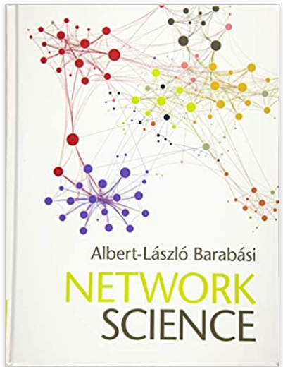

References
Newman, M. (2018). Networks. Oxford university press. Barabási, A. L. (2013). Network science. Philosophical Transactions of the Royal Society A: Mathematical, Physical and Engineering Sciences, 371(1987), 20120375. Watts, D. J. (2004). Six degrees: The science of a connected age. WW Norton & Company. Conference: https://complexnetworks.org/

Slide 6
Node Degree Distribution $P\left(k\right)=N_{k}/N$
A
2
B
4
C
D
3
2
 | A | C | D | B | E | F | ∑
A | 1 | 1 | 1 | 1 | 0 | 0 | 4
C | 1 | 0 | 1 | 1 | 0 | 0 | 3
D | 1 | 1 | 0 | 1 | 0 | 0 | 3
B | 1 | 1 | 1 | 0 | 1 | 1 | 5
E | 0 | 0 | 0 | 1 | 0 | 1 | 2
F | 0 | 0 | 0 | 1 | 1 | 0 | 2
E
A
F
B
C
D

Slide 7
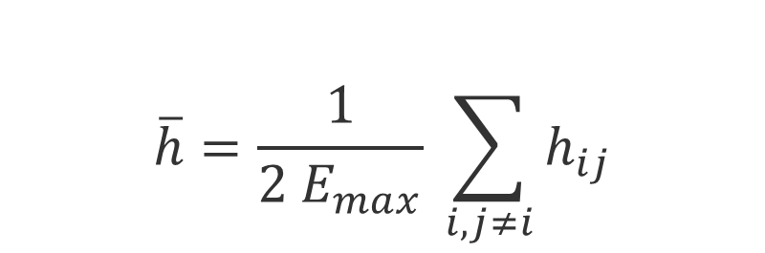
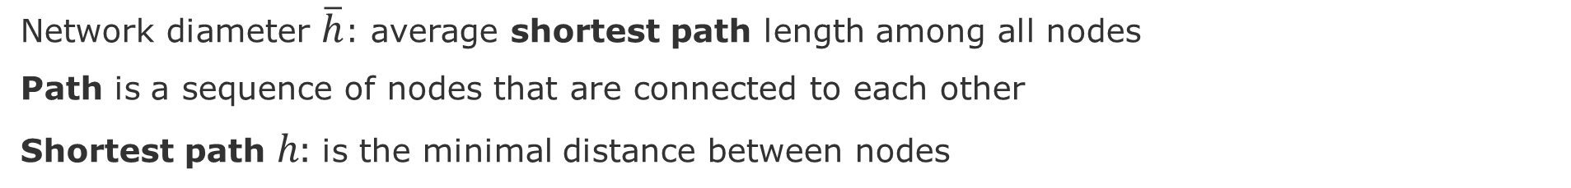
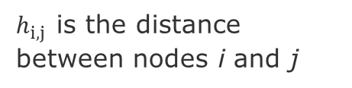
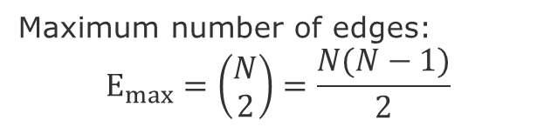
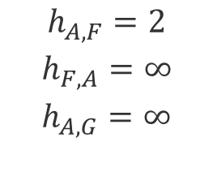
Network Diameter (or geodesic distance)
Network diameter $\overline{h}$: average shortest path length among all nodes
Path is a sequence of nodes that are connected to each other
Shortest path $h:$ is the minimal distance between nodes
E
$$\overline{h}=\frac{1}{2 E_{max}} \sum_{i,j≠i}{h_{ij}}$$
A
F
B
H
C
G
D
Maximum number of edges:
$$E_{max}=\left(\begin{aligned}N \\ 2\end{aligned}\right)=\frac{N(N−1)}{2}$$
$$h_{A,F}=2$$
$$h_{F,A}=∞$$
$$h_{A,G}=∞$$
$h_{i,j }$is the distance between nodes i and j

Slide 8
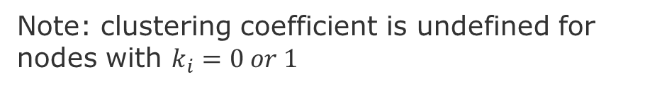
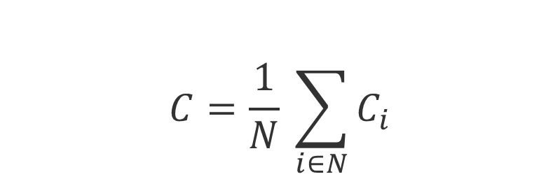

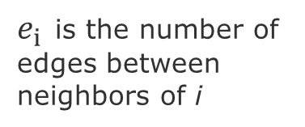
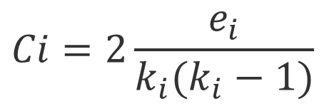
Clustering coefficient $C_{i}$
$C_{i}$Measures how many of my neighbors are connected to each other
$$C_{i}∈\left[0,1\right]$$
$$Ci=2\frac{e_{i}}{k_{i}(k_{i}−1)}$$
A
A
A
A
$e_{i }$is the number of edges between neighbors of i
B
B
B
B
C
C
C
C
D
D
D
D
$$C_{A}$$
0.0
0.3
=2*1/3*2
0.67
=2*2/3*2
1.0
=2*3/3*2
total possible edges
Note: clustering coefficient is undefined for nodes with $k_{i}=0 or 1$
Average Clustering Coefficient
$$C=\frac{1}{N} \sum_{i∈N}{C_{i}}$$
Notes:
Clustering coefficient is undefined for nodes with ki = 0 or 1

Slide 9
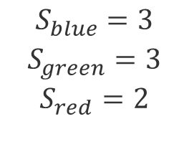
Connectivity $S$
Connectivity $S$: is the largest set of nodes that can be connected through any given path
E
A
F
B
H
C
G
D
$$S_{blue}=3$$
$$S_{green}=3$$
$$S_{red}=2$$

Slide 10
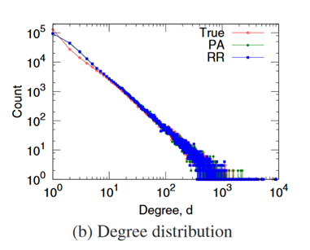
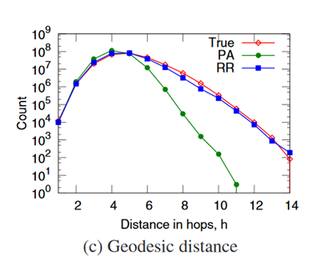
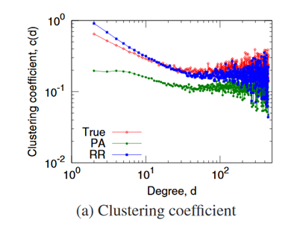
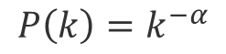
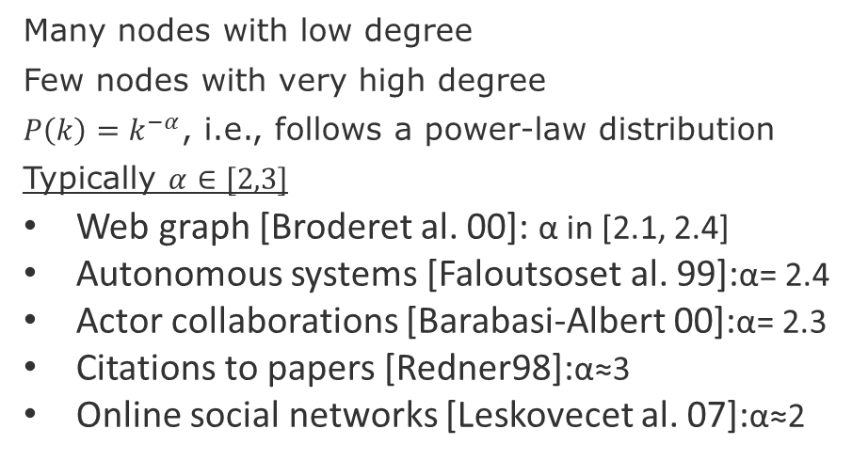
Empirical values (Flickr)
$$P\left(k\right)=k^{−α}$$
Many nodes with low degree
Few nodes with very high degree
$P\left(k\right)=k^{−α}$, i.e., follows a power-law distribution
Typically $α∈[2,3]$
Web graph [Broderet al. 00]: α in [2.1, 2.4]
Autonomous systems [Faloutsoset al. 99]:α= 2.4
Actor collaborations [Barabasi-Albert 00]:α= 2.3
Citations to papers [Redner98]:α≈3
Online social networks [Leskovecet al. 07]:α≈2
Few hops on average allow to reach anywhere in the network
Low degree nodes tend to have higher clustering
Note: remember to plot degree distributions and clustering coefficients in log-log scale
Source: Leskovec, Jure, et al. "Microscopic evolution of social networks." Proceedings of the 14th ACM SIGKDD 2008.

Slide 11
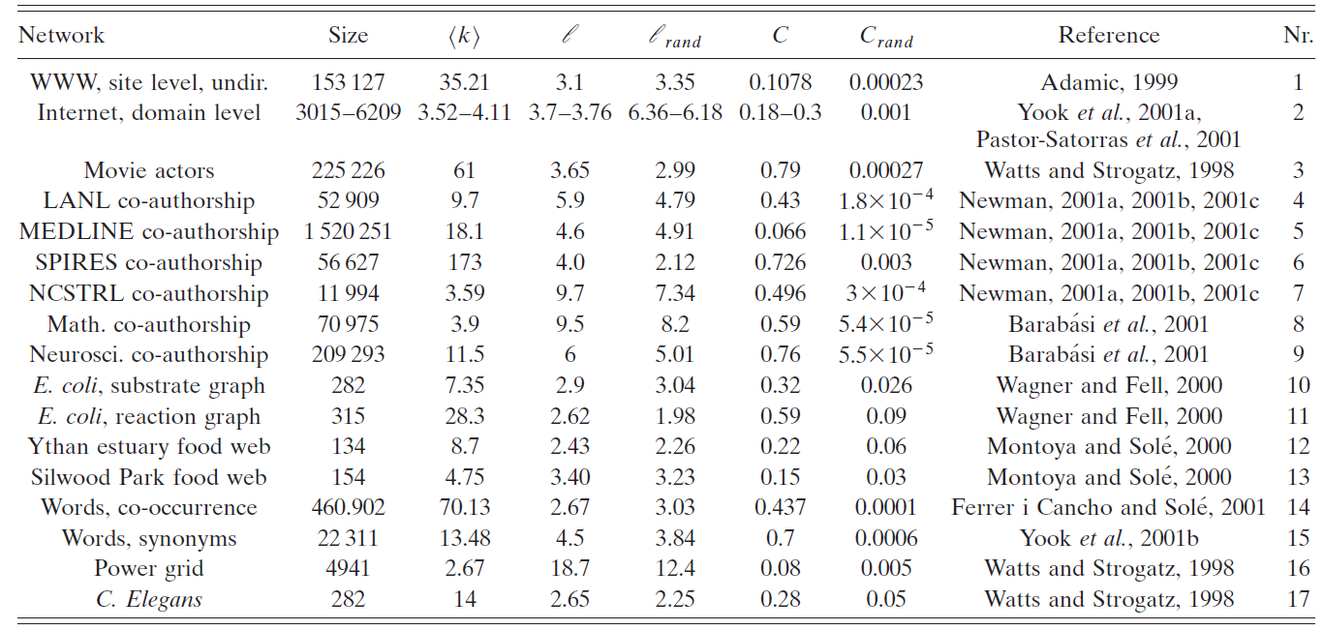
Comparing some networks
Average Clustering coefficient
Average degree
Network diameter
Source:
Albert, R., & Barabási, A. L. (2002). Statistical mechanics of complex networks. Reviews of modern physics, 74(1), 47.

Slide 12
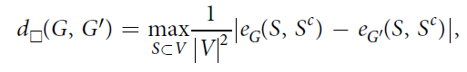
Other ways of comparing networks
Known Node Correspondence Methods:
Difference of the adjacency matrices
DeltaCon (similarity between node pairs)
Cut distance
Unknown Node Correspondence Methods:
global statistics,
matching of subgraphs (graphlets)
Relative Graphlets Frequency Distance (RGFD)
Graphlet Degree Distribution Agreement (GDDA)
alignment-based methods entropy measures (isomorphism)
spectral methods (distance-based)
[Liu et al. 2018]
Tantardini, M., Ieva, F., Tajoli, L., & Piccardi, C. (2019). Comparing methods for comparing networks. Scientific reports, 9(1), 1-19.
Liu, Q., Dong, Z. & Wang, E. (2018) Cut Based Method for Comparing Complex Networks. Sci Rep 8, 5134.

Slide 13
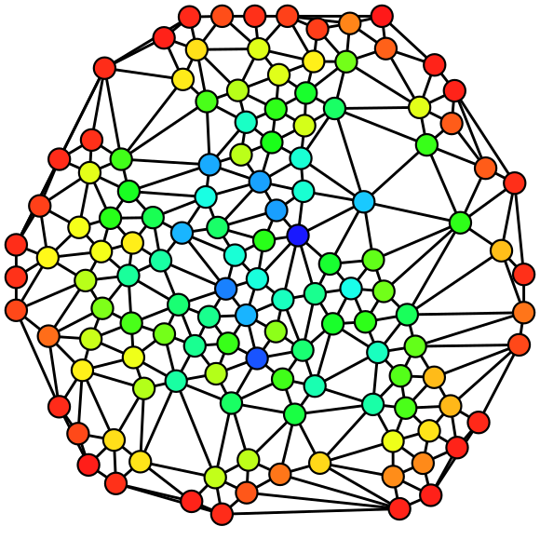
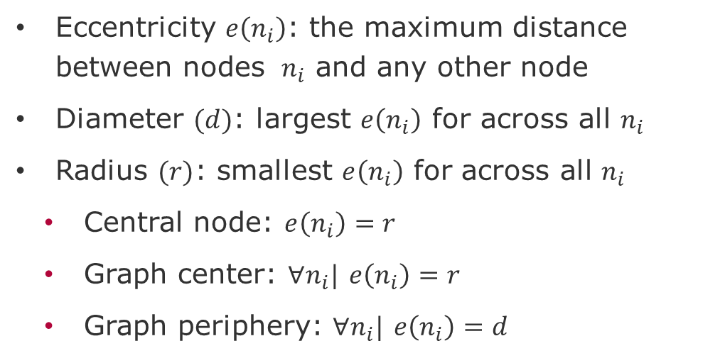
Graph theoretic measures
Eccentricity $e\left(n_{i}\right)$: the maximum distance between nodes $n_{i}$ and any other node
Diameter $(d)$: largest $e\left(n_{i}\right)$ for across all $n_{i}$
Radius $(r)$: smallest $e\left(n_{i}\right)$ for across all $n_{i}$
Central node: $e\left(n_{i}\right)=r$
Graph center: $∀n_{i}|$ $e\left(n_{i}\right)=r$
Graph periphery: $∀n_{i}|$ $e\left(n_{i}\right)=d$
source: Wikipedia

Slide 14
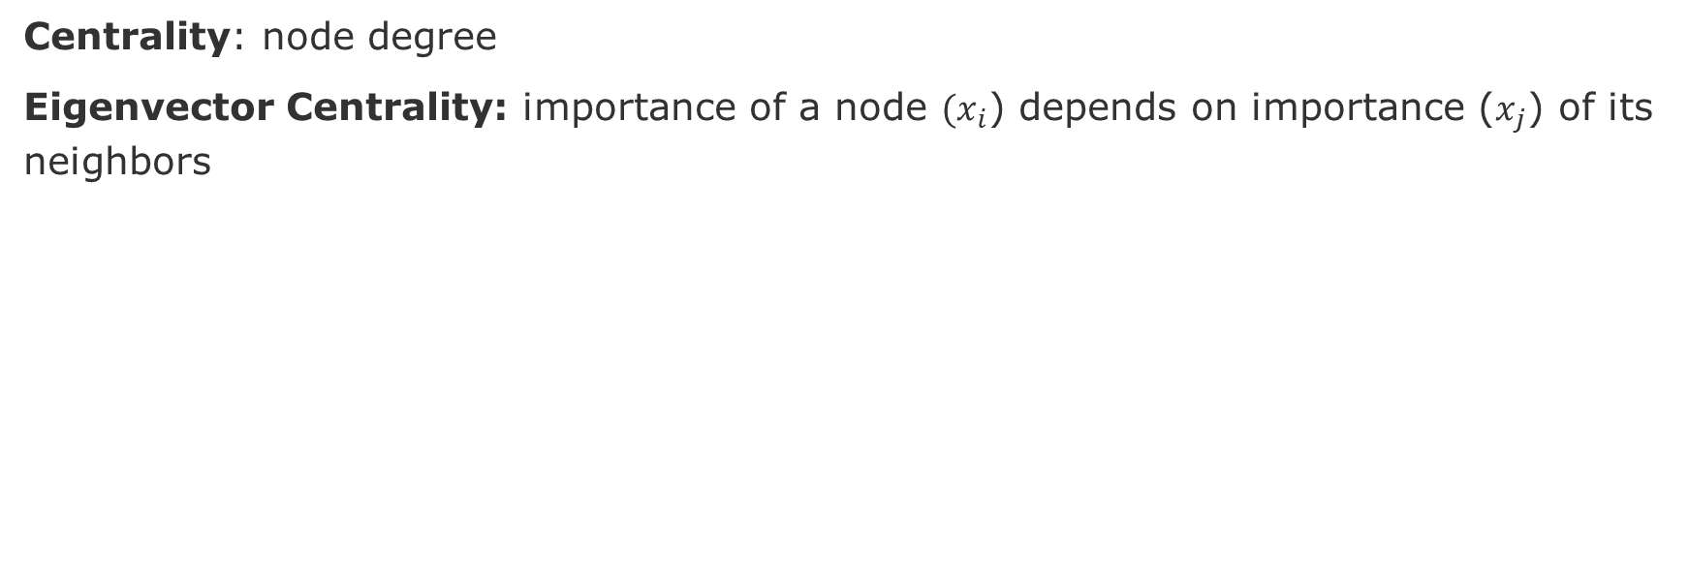
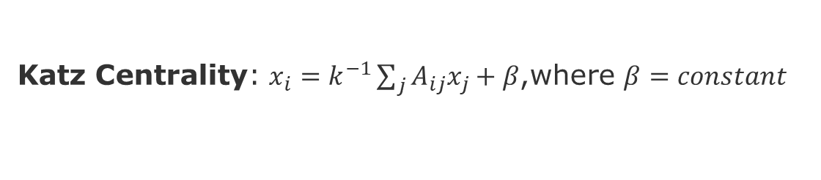
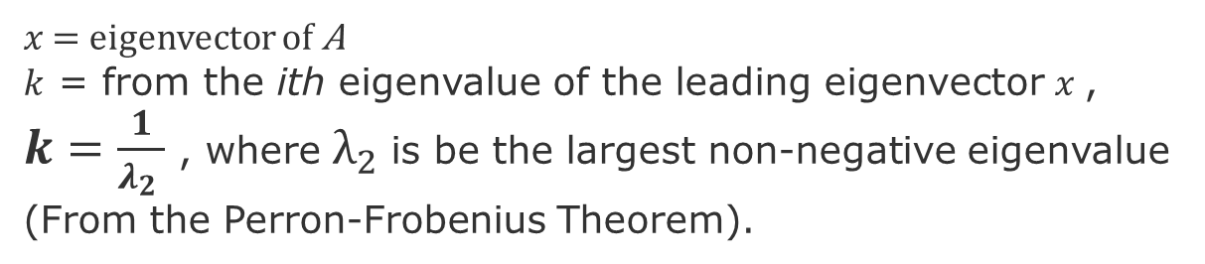
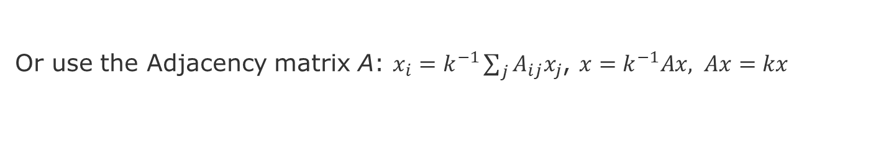
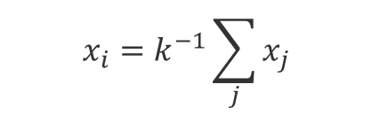

Centrality Metrics – Degree-based
Centrality: node degree
Eigenvector Centrality: importance of a node $(x_{i}$) depends on importance ($x_{j}$) of its neighbors
source: Wikipedia
$$x_{i}=k^{−1}\sum_{j}{x_{j}}$$
Or use the Adjacency matrix A: $x_{i}=k^{−1}\sum_{j}{A_{ij}x_{j}}$, $x=k^{−1}Ax, Ax=kx$
$x$ = eigenvector of A
$k$ = from the ith eigenvalue of the leading eigenvector $x$, $k=\frac{1}{λ_{2} }$ , where $λ_{2}$is be the largest non-negative eigenvalue (From the Perron-Frobenius Theorem).
Katz Centrality: $x_{i}=k^{−1}\sum_{j}{A_{ij}x_{j}}+β$,where $β=constant$
PageRank: $x_{i}=k^{−1}\sum_{j}{A_{ij}\frac{x_{j}}{k_{j}^{out}}}+β$,where $k_{j}^{out}=outdegree of node j$
Newman, Mark. Networks. Oxford university press, 2018.
Borgatti, Stephen P., and Martin G. Everett. "A graph-theoretic perspective on centrality." Social networks 28.4 (2006): 466-484.
Notes:
Caveats of Eigenvector centrality: nodes with outgoing edges only will have centrality zero, acyclic graphs,
Caveat of Katz Centrality, Amazon pointing to many sellers

Slide 15
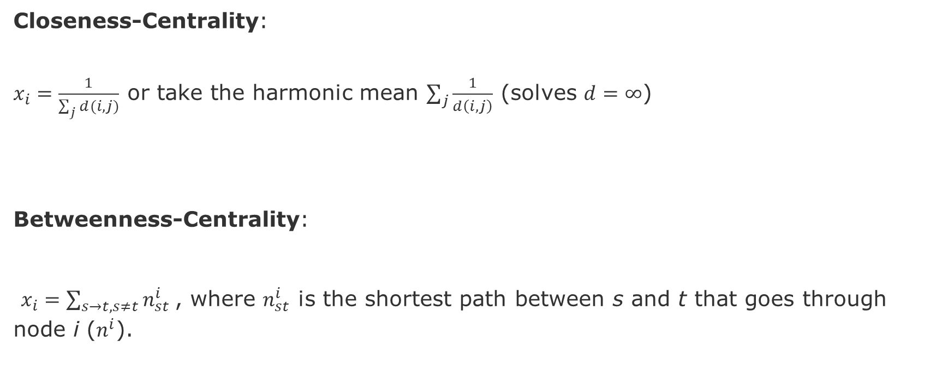
Centrality Metrics – Path-Based
source: Wikipedia
Closeness-Centrality:
$x_{i}=\frac{1}{\sum_{j}{d(i,j)}}$ or take the harmonic mean $\sum_{j}{\frac{1}{d\left(i,j\right)}}$ (solves $d=∞$)
Betweenness-Centrality:
$x_{i}=\sum_{s→t, s≠t}{n_{st}^{i}}$, where $n_{st}^{i}$ is the shortest path between s and t that goes through node i ($n^{i}$).
Newman, Mark. Networks. Oxford university press, 2018.
Borgatti, Stephen P., and Martin G. Everett. "A graph-theoretic perspective on centrality." Social networks 28.4 (2006): 466-484.

Slide 16
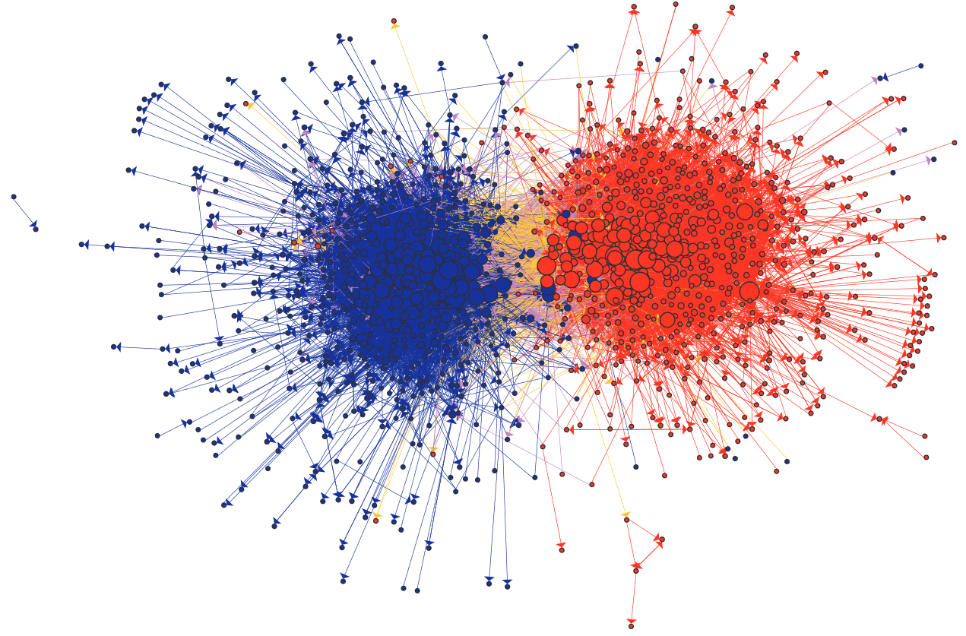
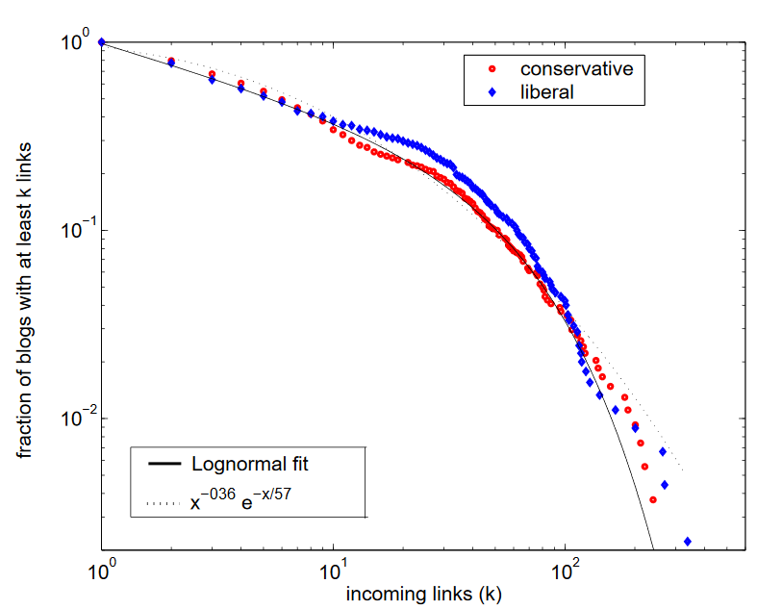
Political Blogosphere [Adamic & Glance 2005]
Cumulative distribution of incoming links for political blogs by category
Similar distributions can be fit with lognormal or exponential functions.
Larger blogs are more central
Homophily
Yellow links show blogs from opposite views commenting on each other
Source: Adamic, Lada A., and Natalie Glance. "The political blogosphere and the 2004 US election: divided they blog." Proceedings of the 3rd international workshop on Link discovery. 2005.
Notes:
The lack of overlap in lib-
eral and conservative interests has previously been observed
in purchases of political books on Amazon.com [8]. This
brings about the question of whether we are witnessing a
cyberbalkanization [11, 13] of the Internet, where the prolif-
eration of specialized online news sources allows people with
different political leanings to be exposed only to information
in agreement with their previously held views.
liberal and conservative
blogs did indeed have different lists of favorite news sources, people, and topics to discuss, although they occasionally
overlapped in their discussion of news articles and events.
The division between liberals and conservatives was further
reflected in the linking pattern between the blogs, with a
great majority of the links remaining internal to either lib-
eral or conservative communities.

Slide 17
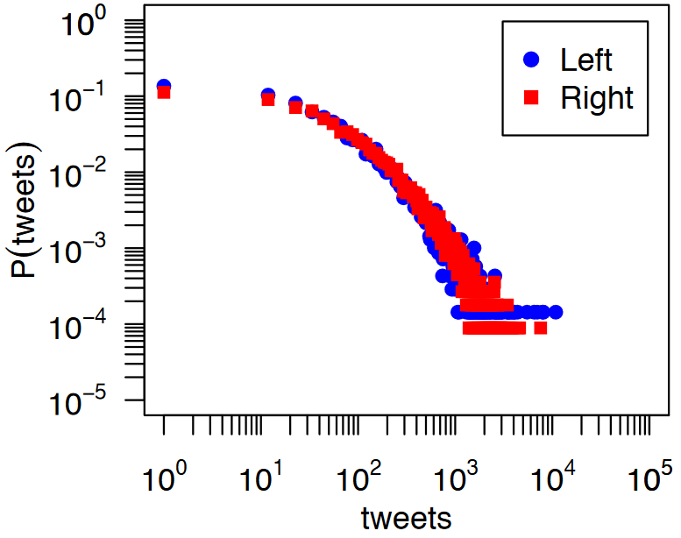
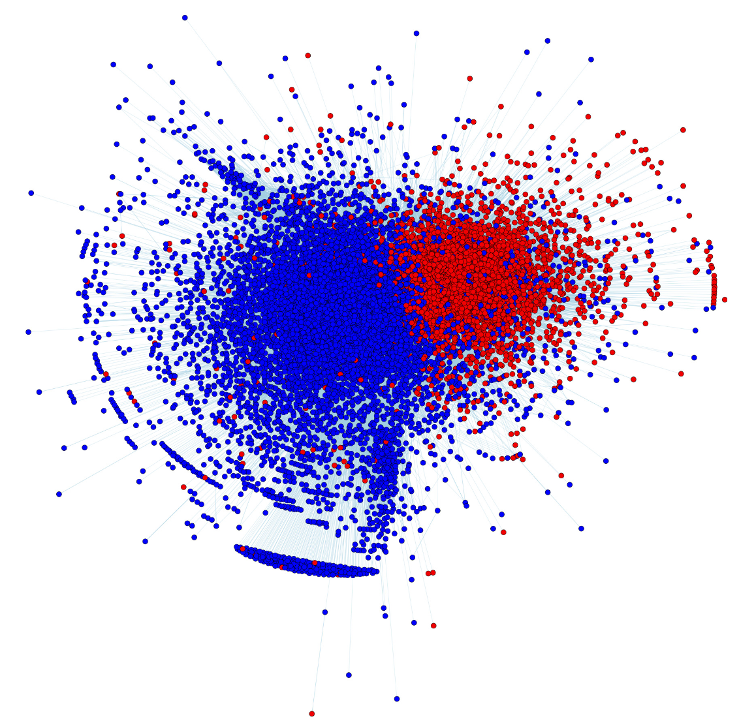
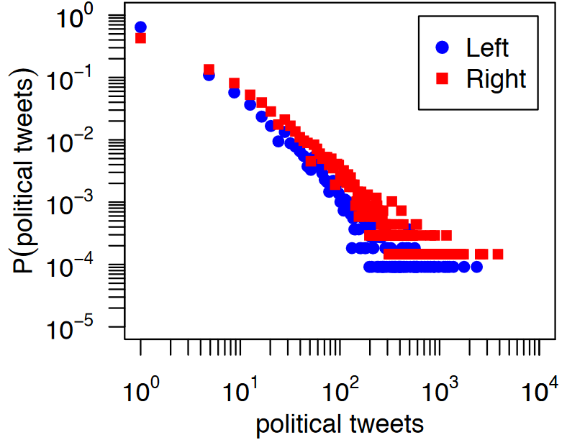
Partisan Asymmetries in Twitter [Conover et al. 2012]
Both groups produce same amount of tweets per capita
tweets = number of tweets a user posts
P(tweets) probability of a user
Right-leaning produce 2x more political content
One or more political hash tags
Right-leaning= 22% of tweets
Left-leaning= 12% of tweets
source: Conover, Michael D., et al. "Partisan asymmetries in online political activity." EPJ Data Science 1.1 (2012): 6.
Notes:
right-leaning users were almost twice as likely to create political content, with22%of all tweets produced by right-leaning userscontaining one or more of the political hashtags under study, compared to only12%for left-leaning users.

Slide 18
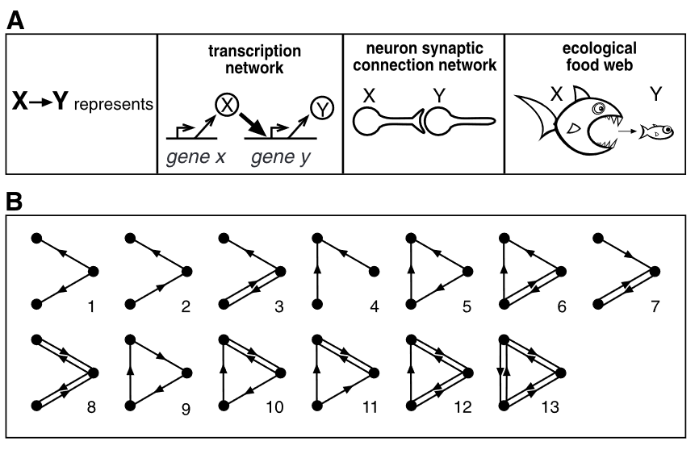
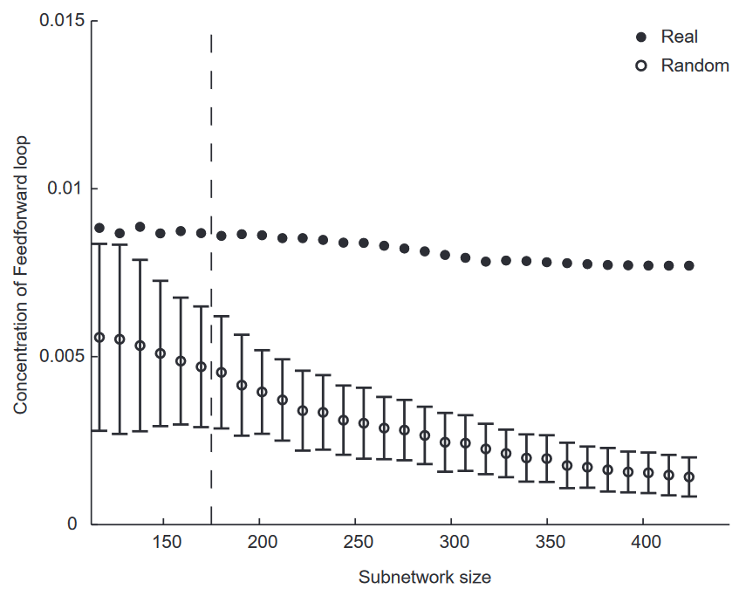
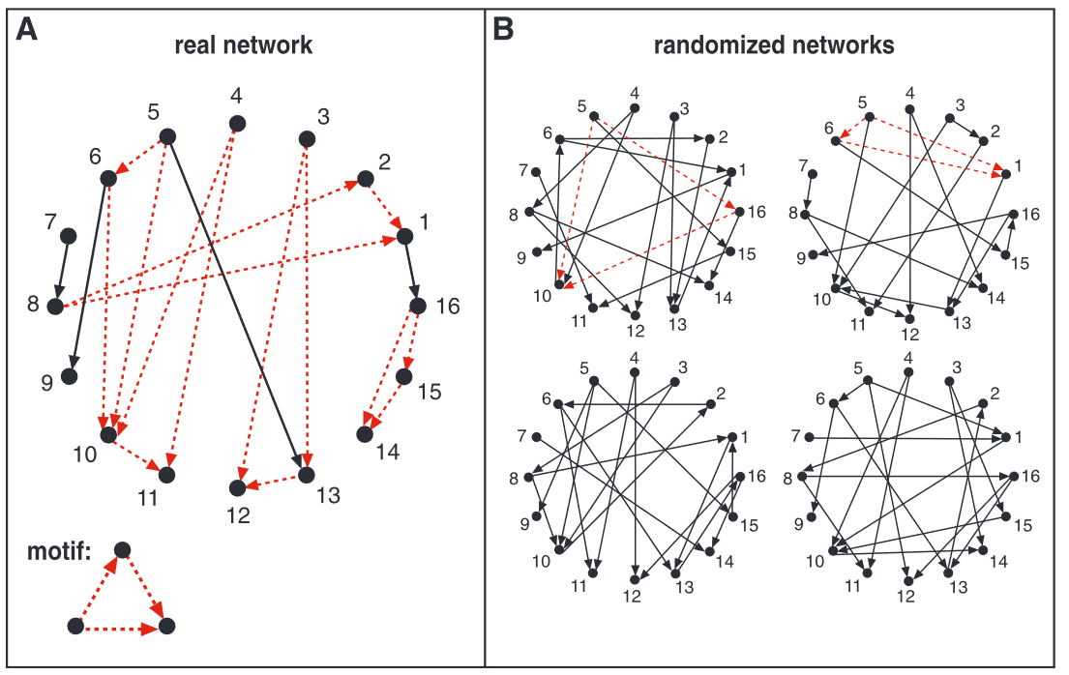
Motifs [Milo 2002]
Remarks
Number of motifs grow exponentially with the number of edges
Real networks tend to be rich in motifs, whereas Random networks not.
As Real networks evolve, their motif count remains stable, whereas in Random networks, it colapses.
This might suggest that motifs provide struture to the proper functioning of these networks
[Milo 2002] Milo, R. et al. Network motifs: Simple building blocks of complex networks. Science 298, 824–827 (2002).

Slide 19
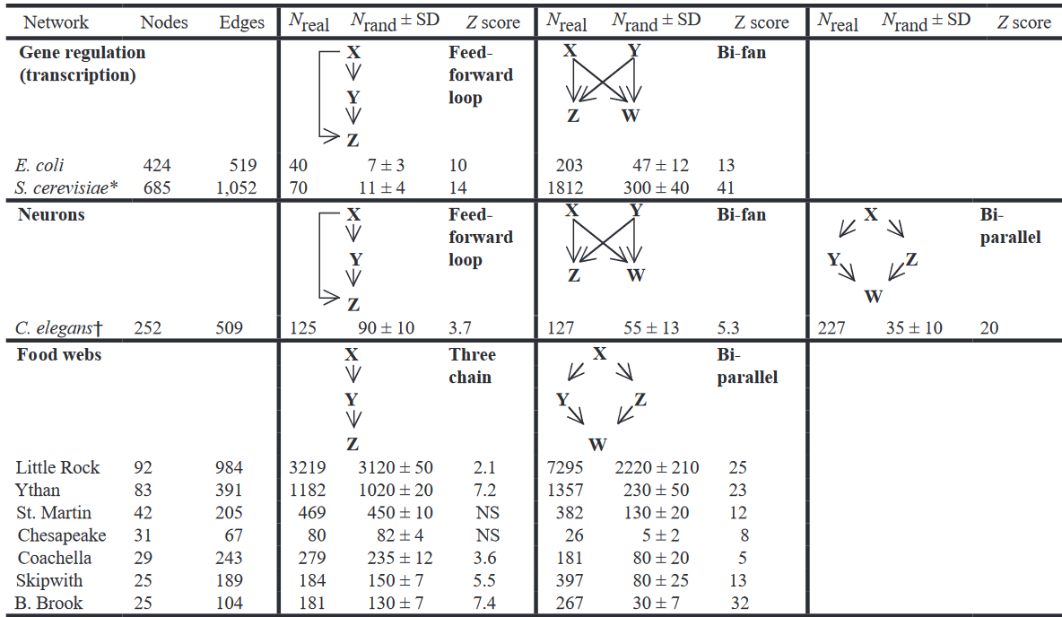
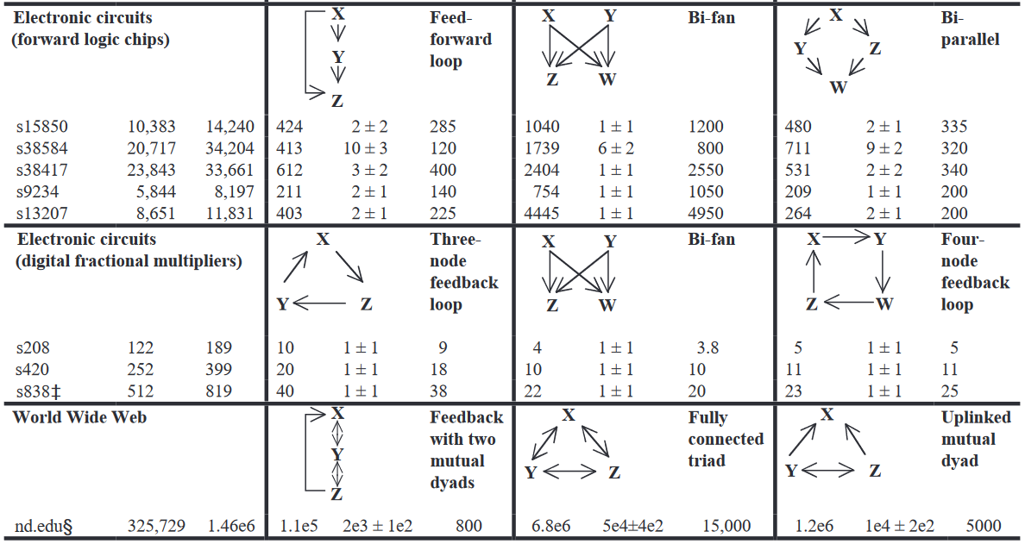
Motifs in real networks
Biological
Technological
Milo, R. et al. Network motifs: Simple building blocks of complex networks. Science 298, 824–827 (2002).

Slide 20
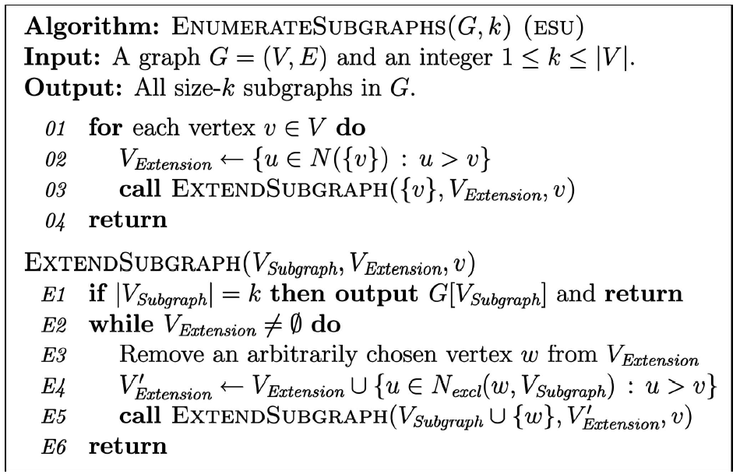
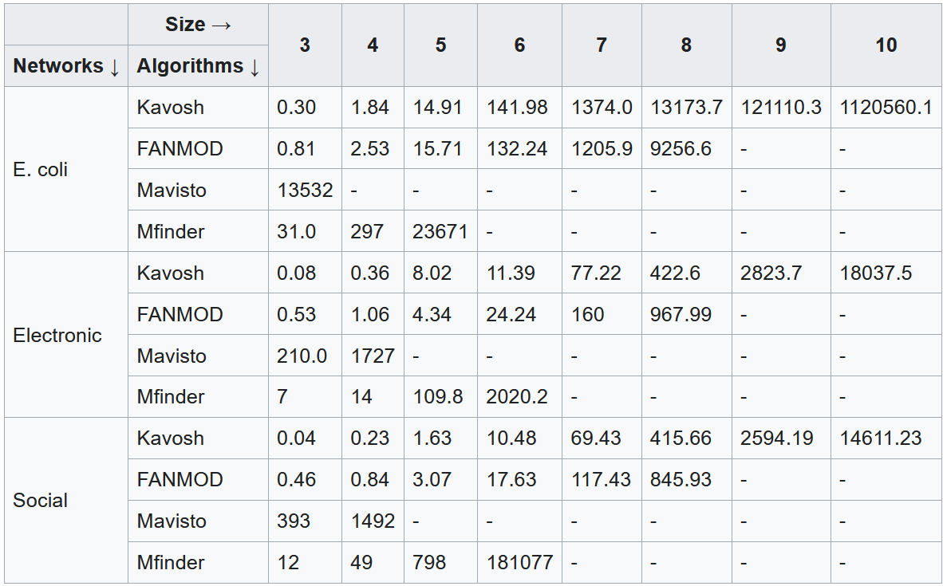
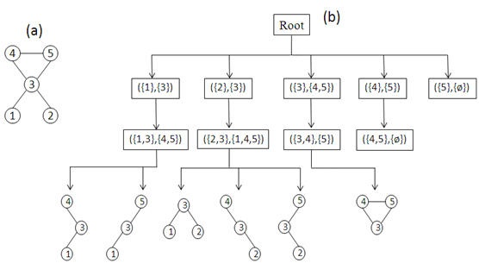
Motif counting – ESU (FANMOD) algorithm [Wernicke 2006]
EXT set of all the nodes that :
are adjacent to at least one of the nodes in SUB (guarantees expansion is a connected graph)
their numerical labels must be larger than the label of first element in SUB. (guarantees termination)
Many other algorithms have bee developed and tested
[Wernicke 2006] Wernicke S (2006). "Efficient detection of network motifs". IEEE/ACM Transactions on Computational Biology and Bioinformatics. 3 (4): 347–359.
Author: CC BY-SA 3.0, https://en.wikipedia.org/w/index.php?curid=36822191
https://en.wikipedia.org/wiki/Network_motif#Motif_discovery_algorithms
Notes:
FANMOD == ESU

Slide 21
Motif caveats
Caveats
Stability of a network structure not necessary imply function stability [Igram et al. 2006]
Network structure not always imply function [Voigt et al. 2005]
Static analysis might hide the relationship between structure and function
Temporal network motifs have been investigated [Braha & Bar-Yam 2009][Holme & Saramäki 2012]
[Braha & Bar-Yam 2009] Braha D., Bar-Yam Y. (2009). “Time-Dependent Complex Networks: Dynamic Centrality, Dynamic Motifs, and Cycles of Social Interactions.” In: Gross T., Sayama H. (eds) Adaptive Networks. Understanding Complex Systems. Springer, Berlin, Heidelberg
[Holme & Saramäki 2012] Holme, P., & Saramäki, J. (2012). Temporal networks. Physics reports, 519(3), 97-125.
[Ingram et al. 2006] Ingram PJ, Stumpf MP, Stark J (2006). "Network motifs: structure does not determine function". BMC Genomics. 7: 108.
[Voigt et al. 2005] Voigt CA, Wolf DM, Arkin AP (2005). "The Bacillus subtilis sin operon: an evolvable network motif". Genetics. 169 (3): 1187–202.

Slide 22
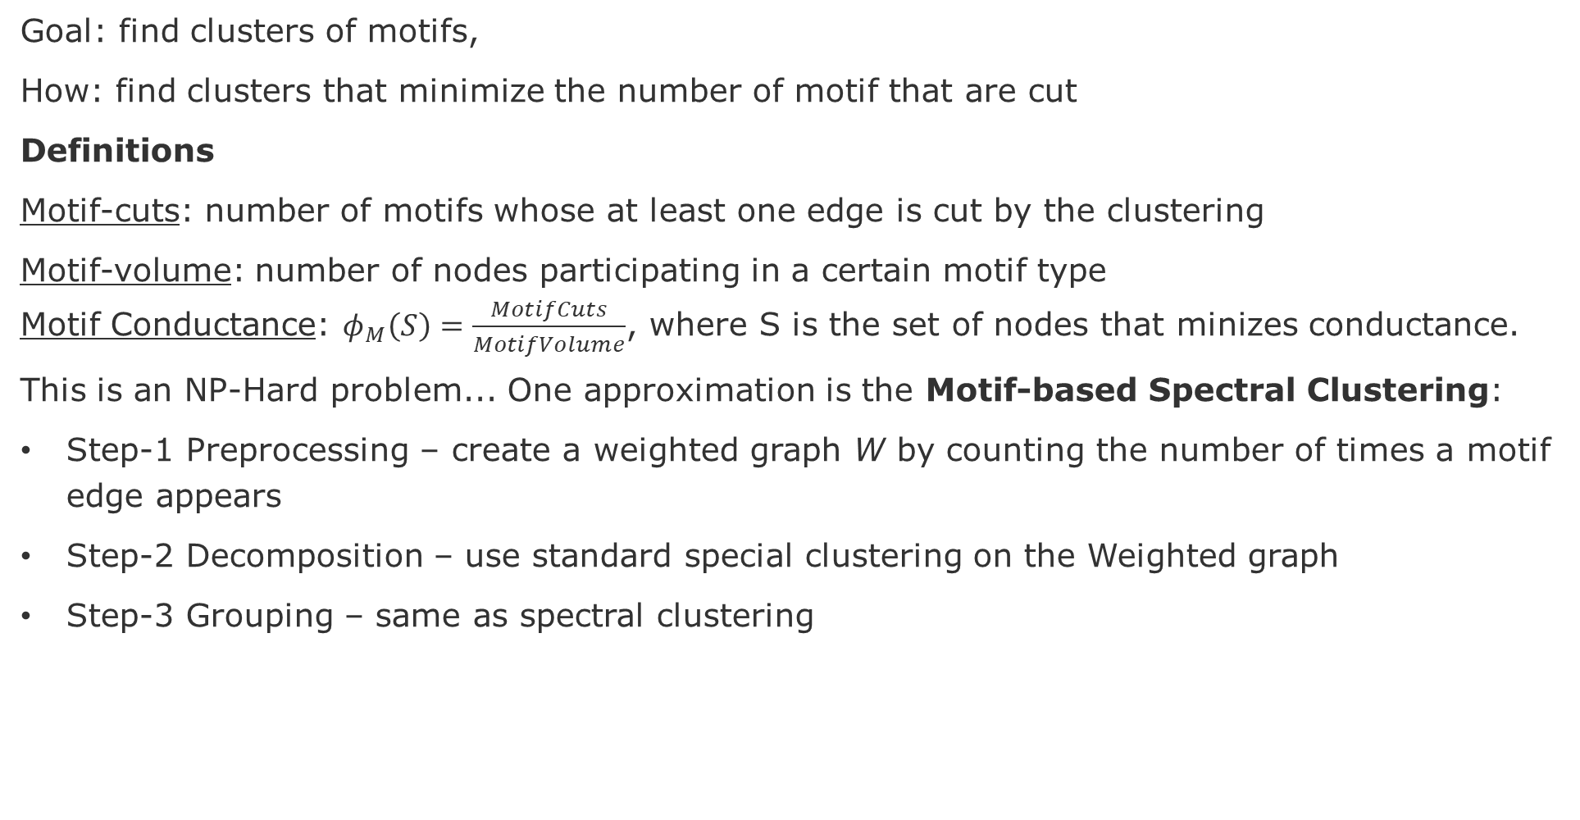
Motif-based spectral clustering
Goal: find clusters of motifs,
How: find clusters that minimize the number of motif that are cut
Definitions
Motif-cuts: number of motifs whose at least one edge is cut by the clustering
Motif-volume: number of nodes participating in a certain motif type
Motif Conductance: $φ_{M}\left(S\right)=\frac{MotifCuts}{MotifVolume}$, where S is the set of nodes that minizes conductance.
This is an NP-Hard problem... One approximation is the Motif-based Spectral Clustering:
Step-1 Preprocessing – create a weighted graph W by counting the number of times a motif edge appears
Step-2 Decomposition – use standard special clustering on the Weighted graph
Step-3 Grouping – same as spectral clustering
Lu, Zhenqi, Johan Wahlström, and Arye Nehorai. "Community detection in complex networks via clique conductance." Scientific reports 8.1 (2018): 1-16.
Notes:
Lu, Zhenqi, Johan Wahlström, and Arye Nehorai. "Community detection in complex networks via clique conductance." Scientific reports 8.1 (2018): 1-16.

Slide 23
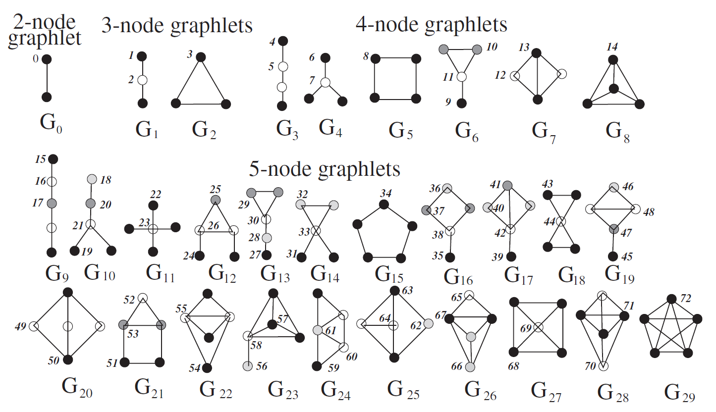
Graphlets
Automorphism orbits 0,1,2, . . . , 72 for the thirty 2, 3, 4, and 5-node graphlets G0,G1, . . . ,G29. In a graphlet Gi, i 2 {0,1,. . .29}, nodes belonging to
the same orbit are of the same shade
source: Pržulj, N., Biological network comparison using graphlet degree distribution, Bioinformatics, 23, 2, 2007, pp, e177–e183

Slide 24
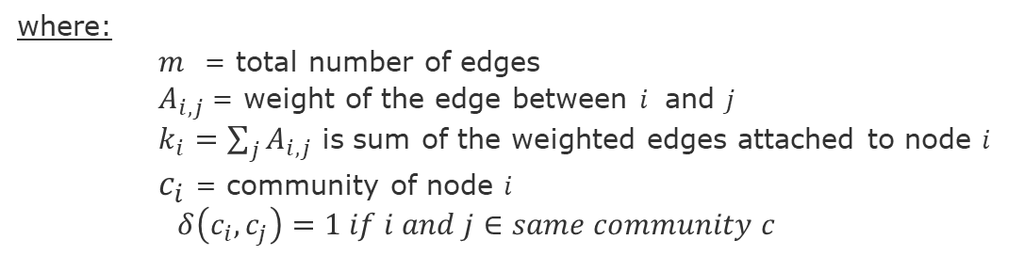
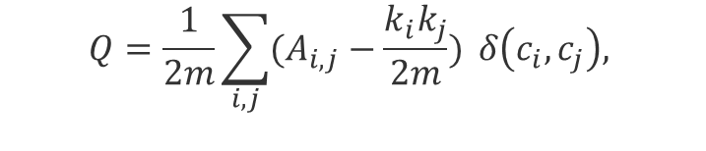
Modularity (Q) – quality of clustering
Modularity (Q) fraction of the edges within the given groups minus the expected such fraction if edges were distributed at random. It is defined as [Newman 2004]:
Actual connection between i and j
$$Q=\frac{1}{2m}\sum_{i,j}{(A_{i,j}−\frac{k_{i}k_{j}}{2m})} δ\left(c_{i},c_{j}\right),$$
If nodes were randomly connected
(null model)
where:
$m$ = total number of edges
$A_{i,j}$= weight of the edge between $i$ and $j$
$k_{i}=\sum_{j}{A_{i,j}}$ is sum of the weighted edges attached to node $i$
$c_{i}$ = community of node $i$
$δ\left(c_{i},c_{j}\right)=1 if i and j∈same community c$
[Newman 2004] Newman, Mark EJ. "Analysis of weighted networks." Physical review E 70.5 (2004): 056131.
[Blondel et al. 2008] Blondel, Vincent D., et al. (2008), "Fast unfolding of communities in large networks.“, Journal of statistical mechanics: theory and experiment, 2008(9), pp.1-13.

Slide 25
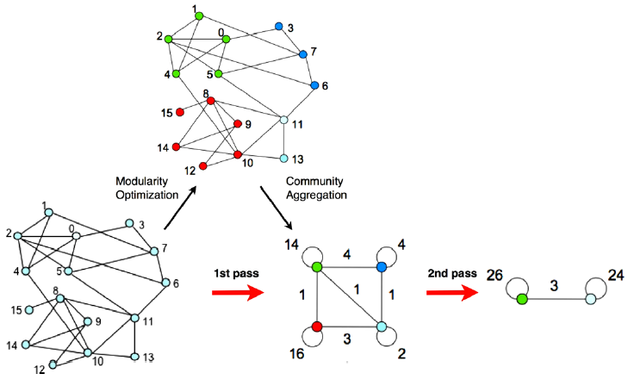
Louvain Algorithm
Iterate until find the lowest modularity value

Slide 26
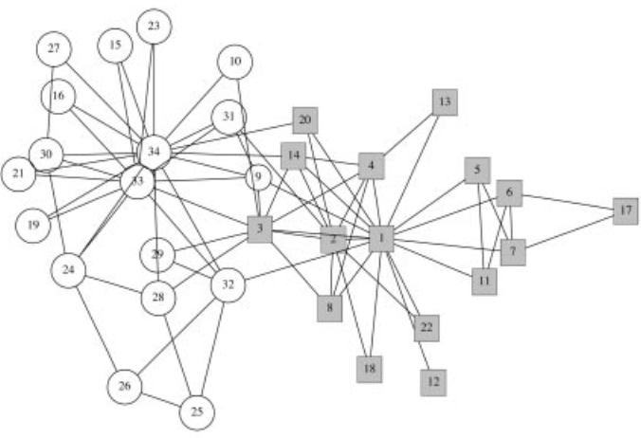
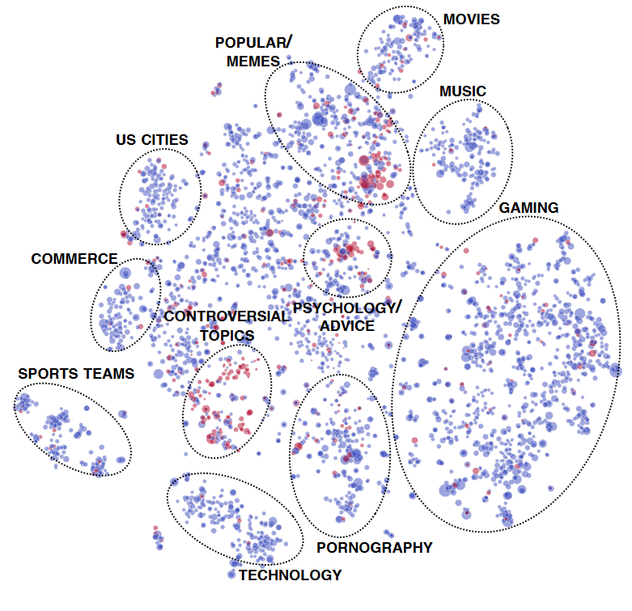
Community structure
Zachary’s Karate Club Split [Girvan et al. 2002]
Reddit Communities [Kumar, et al. 2018]
Instructor group
Club Admin group
[Girvan et al. 2002] Girvan, Michelle, and Mark EJ Newman. "Community structure in social and biological networks." Proceedings of the national academy of sciences 99.12 (2002): 7821-7826.
[Kumar et al. 2018] Kumar, S., Hamilton, W. L., Leskovec, J., & Jurafsky, D. (2018, April). Community interaction and conflict on the web. In Proceedings of the 2018 World Wide Web Conference (pp. 933-943).
Notes:
[Newman 2002] Newman, M. E. J. (2003). "Mixing patterns in networks". Physical Review E. American Physical Society (APS). 67 (2):

Slide 27
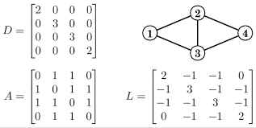


Spectral Clustering
1. Build Graph Laplacian representation:
$$Laplacian matrix (L)= Adjacency matrix (A) – Degree matrix (D)$$
2. Reduce Dimensionality:
Compute eigenvalues and eigenvectors of the L matrix
Use eigenvectors to map nodes to a reduced representation
3. Categorize:
Use the new representation, assign nodes to clusters
L = A-D
Further resources
Short Tutorial on Graph Laplacian: https://csustan.csustan.edu/~tom/Clustering/GraphLaplacian-tutorial.pdf
Lecture Slides: http://graphics.stanford.edu/courses/cs468-10-fall/LectureSlides/16_spectral_methods1.pdf
Tutorial on Spectral Clustering: nhttps://www.cs.cmu.edu/~aarti/Class/10701/readings/Luxburg06_TR.pdf

Slide 28



Homophily metrics
Definition: Preference to attach to nodes that are similar [Newman 2003]
Assortativity Coefficient (Pearson Correlation)
Neighborhood Connectivity
[Newman 2003] Newman, M. E. J. (2003). "Mixing patterns in networks". Physical Review E. American Physical Society (APS). 67 (2):

Slide 29






Node equivalence
$$j_{ij}=\frac{n_{ij}}{k_{i}+ k_{j}−n_{ij}}$$
Structural equivalence
Jaccard Similarity (intersection)
Cosine Similarity (distance)
Pearson Correlation
Euclidean Distance (dissimilarity)
Node overlap
Regular equivalence
Nodes that do not necessarily share neighbors, but have similar features
$$σ_{ij}=\frac{n_{ij}}{{\sqrt{k_{i}k_{j}}}_{i}}$$
$$O_{i,j}= \frac{| (N_{i}⋂N_{j})\backslash \{i,j\}|}{|(N_{i}⋃N_{j})\backslash \{i,j\}|}$$
i
j
i
j
i
j
$$O_{ij}=0$$
$$O_{ij}=1/3$$
$$O_{ij}=2/3$$

Slide 30
Things to think about
Initial understanding about your graph data
What are possible the edges and nodes (and corresponding types) of your network?
What types of networks w.r.t. edge directionality?
What type of networks w.r.t. to node types?
Is your network possibly assortative, dissortative, or neither?
Which centrality metrics might make sense for you?
Are there communities/clusters that can be used as features?
Do you believe your graph will present high or low cluster coefficient?
What about the network diameter (low or high)?

Slide 31
Graph/Network Metrics
Oehlers, M., & Fabian, B. (2021). Graph Metrics for Network Robustness—A Survey. Mathematics, 9(8), 895.
Ramos, A., Lazar, M., Holanda Filho, R., & Rodrigues, J. J. (2017). Model-based quantitative network security metrics: A survey. IEEE Communications Surveys & Tutorials, 19(4), 2704-2734.
Donnat, C., & Holmes, S. (2018). Tracking network dynamics: A survey of distances and similarity metrics. arXiv preprint arXiv:1801.07351.
Wan, Z., Mahajan, Y., Kang, B. W., Moore, T. J., & Cho, J. H. (2021). A survey on centrality metrics and their network resilience analysis. IEEE Access, 9, 104773-104819.
Dhyani, D., Ng, W. K., & Bhowmick, S. S. (2002). A survey of web metrics. ACM Computing Surveys (CSUR), 34(4), 469-503.

Slide 32
Temporal Graph Phenomena
Lv, L., Zhang, K., Zhang, T., Bardou, D., Zhang, J., & Cai, Y. (2019). PageRank centrality for temporal networks. Physics Letters A, 383(12), 1215-1222.
Williams, M. J., & Musolesi, M. (2016). Spatio-temporal networks: reachability, centrality and robustness. Royal Society open science, 3(6), 160196.
Holme, P., & Saramäki, J. (2012). Temporal networks. Physics reports, 519(3), 97-125.
Michail, O., & Spirakis, P. G. (2016). Traveling salesman problems in temporal graphs. Theoretical Computer Science, 634, 1-23.
Wu, H., Huang, Y., Cheng, J., Li, J., & Ke, Y. (2016, May). Reachability and time-based path queries in temporal graphs. In 2016 IEEE 32nd International Conference on Data Engineering (ICDE) (pp. 145-156). IEEE.
Pereira, F. S., de Amo, S., & Gama, J. (2016, June). Evolving centralities in temporal graphs: a twitter network analysis. In 2016 17th IEEE international conference on mobile data management (MDM) (Vol. 2, pp. 43-48). IEEE.
Erlebach, T., Hoffmann, M., & Kammer, F. (2021). On temporal graph exploration. Journal of Computer and System Sciences, 119, 1-18.
Notes:
Also look at: Page, L., Brin, S., Motwani, R., & Winograd, T. (1999). The PageRank citation ranking: Bringing order to the web. Stanford InfoLab.

Slide 33
Temporal Graph/Network Metrics
Sizemore, A. E., & Bassett, D. S. (2018). Dynamic graph metrics: Tutorial, toolbox, and tale. NeuroImage, 180, 417-427.
Ghanem, M., Magnien, C., & Tarissan, F. (2018). Centrality metrics in dynamic networks: a comparison study. IEEE Transactions on Network Science and Engineering, 6(4), 940-951
Ghanem, M. (2018). Temporal centralities: a study of the importance of nodes in dynamic graphs (Doctoral dissertation, Sorbonne Université).
Kim, H., & Anderson, R. (2012). Temporal node centrality in complex networks. Physical Review E, 85(2), 026107.
Buß, S., Molter, H., Niedermeier, R., & Rymar, M. (2020, August). Algorithmic aspects of temporal betweenness. In Proceedings of the 26th ACM SIGKDD International Conference on Knowledge Discovery & Data Mining (pp. 2084-2092).
Wu, H., Cheng, J., Huang, S., Ke, Y., Lu, Y., & Xu, Y. (2014). Path problems in temporal graphs. Proceedings of the VLDB Endowment, 7(9), 721-732.

Slide 34
Warm-up task
Choose at least three distinct Temporal Graph Metrics each person. Please cover at least: Temporal Degree Centrality [Kim & Anderson 2012], Temporal Betweenness Centrality [Buß et al. 2020], and Temporal Closeness Centrality [Wu et al. 2014].
Answer the following questions:
What are the impacts on measurements and comparisons if we make temporal information less precise (e.g., more coarse-grained)?
For each temporal graph metric that you study:
What are the assumptions about the temporal graph (e.g., expected characteristics and constraints on the represented phenomenon)?
What are the hyperparameters and parameters of construction of these temporal graphs?

Slide 35
END

